Slide 1

I/A Septic System Tracking
Brian Baumgaertel
Barnstable County
Department of Health and Environment

Slide 2
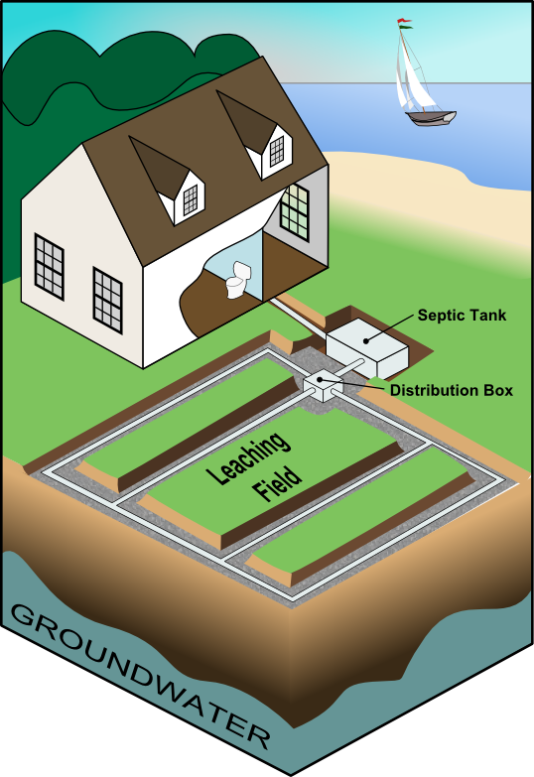
What is an I/A System?
Add-on or replacement for standard onsite septic components for enhanced wastewater treatment.
Typically includes mechanical components such as pumps, filters and bacterial growth media.
In southeastern Massachusetts, typically installed to reduce nitrogen.
A typical septic system.
Notes:
Composting toilets
“Black Boxes” – Bioclere, FAST, &c.
Leach field technologies – pressure dose, drip dispersal

Slide 3
Block Diagram
“Standard” Septic System
“Typical” I/A Septic System
Incoming Wastewater
Incoming Wastewater
Septic Tank
Septic Tank
Recirculation
“Black Box”
Leach Field
Leach Field
Alternative Drainfield

Slide 4
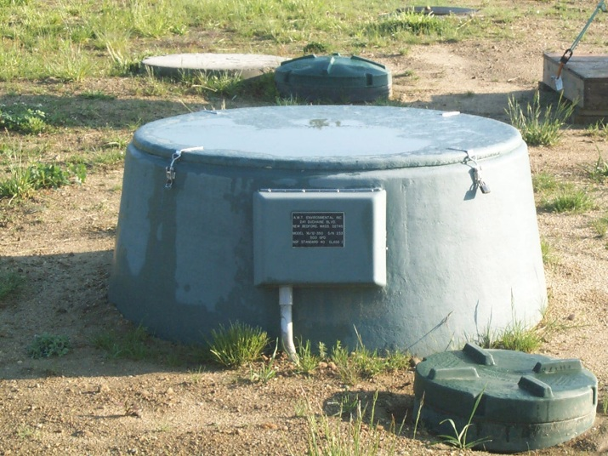
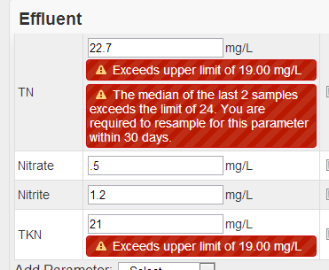
What we do at BCDHE
What the Barnstable County Department of Health and Environment is doing in the world of onsite technology.

Slide 5
Tracking I/A – Program Summary
Developed a web-based database to track I/A Systems for compliance in 15 towns.
Track operation and maintenance (O&M) contracts.
Track maintenance and sampling reports.
Contact homeowners on behalf of BOH to provide the “first level of defense” against non-compliant I/A systems.
Inform BOH of resistant homeowners for further compliance follow-up.

Slide 6
Tracking I/A – Funding Mechanism
Administrative costs funded by a database user fee of $50.00 per year per system.
Fee is charged to system operators on a yearly basis and is based on the number of contracts that they hold as of the first of each fiscal year.
Ex – Joe Schmoe, Inc. has 10 systems as of July 1st -> invoice will be for $500.00.
Fee is reduced to $25 for existing systems the first year.
Failure to pay results in suspension of database access and operator is in violation of requirement to report.

Slide 7
“Always make the computer do the busy work. I hate doing busy work.”
-ME

Slide 8
Making the Computer do the Busy Work
Operator submits contract cancellation
Contract marked canceled
Permit flagged for follow-up
Administrator Notified
Homeowner notified via email or text message
Health Agent notified

Slide 9
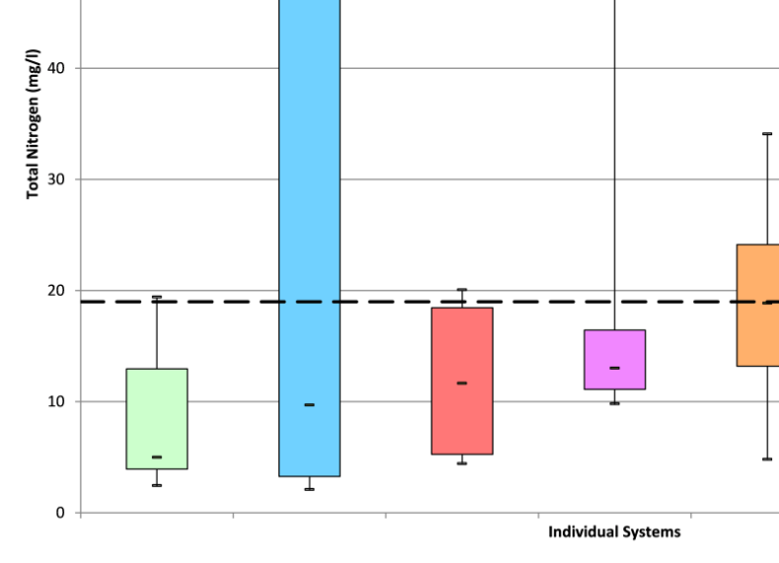
I/A System Performance
Using real-world data to help clarify the question of the efficacy of I/A technologies in wastewater planning.

Slide 10
What is meant by “Performance”?
The ability of an I/A system to remove a particular contaminant.
Nitrogen
19 mg/l residential
25 mg/l commercial

Slide 11
Why 19mg/l for Nitrogen?
Assumptions:
2.9kg nitrogen per person per year
55 gallons water use per person per day
System Influent Concentration:
~38 mg/l Total Nitrogen
50 Percent Removal:
19 mg/l Total Nitrogen

Slide 12











Where Our Data Comes From
1,725
I/A Systems
15,400
Sample Reports
110,000+ Individual Water Quality Data Points

Slide 13
Single Family System Performance
76.9%
26.4%

Slide 14


Box-Whisker Diagrams
Min/Max Value
Min/Max Value
Box
Median – Middle Value
Whiskers
50%
25%
25%
Probability Density Graph (“Bell Curve”)

Slide 15
Box-Whisker Diagram Examples
A – A “Good” System. Box and whiskers are short and compact.
B – A “Bad” System. Results are all over the place. Box and whiskers are stretched out.
C – A “Consistently Bad” System. Compact but well above TN limit (19 mg/l)
D – A “Usually Pretty Good” System. Compact but maybe a couple of high results.
A
B
C
D

Slide 16
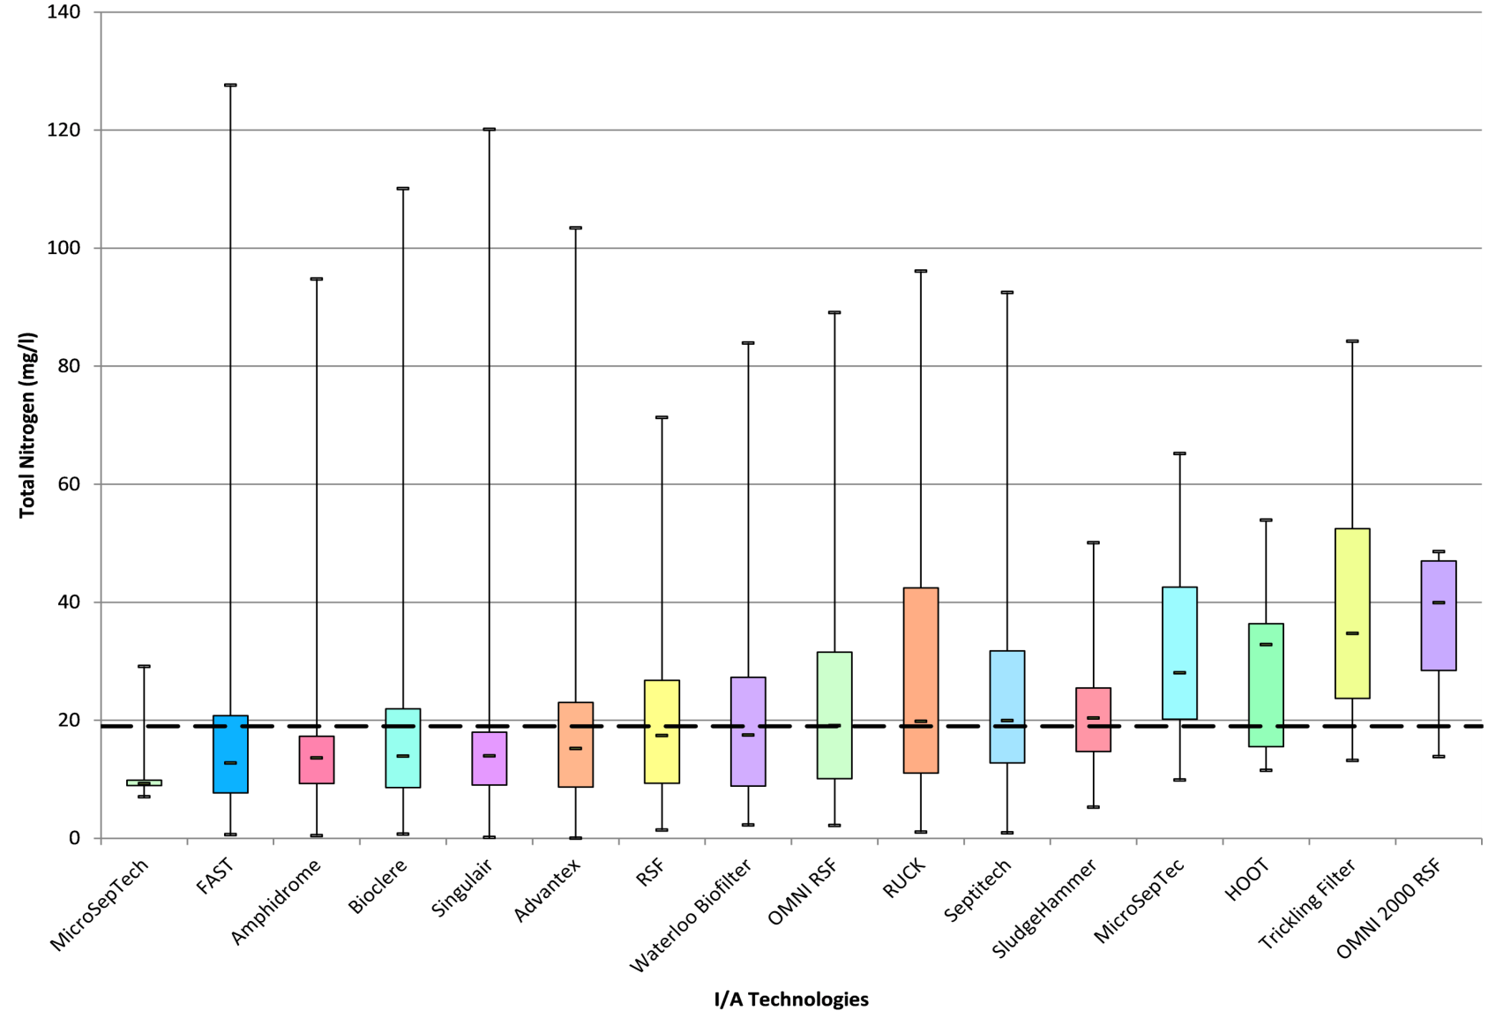
Single Family Technologies

Slide 17
System Performance Tracking
Bio
Bio
Bio
Sin
Adv
FAS
Sin
Bio
Wat
Sin

Slide 18
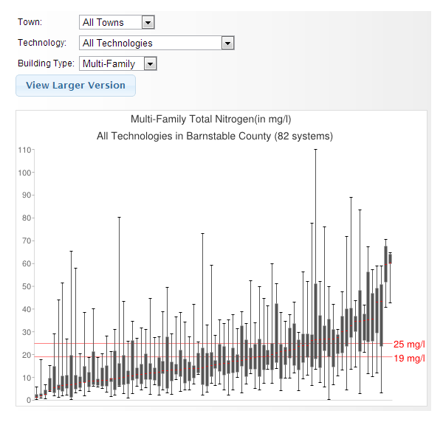
More Data Online!
septic.barnstablecountyhealth.org
Interactive I/A Data
Drill down by
  Town
  Technology
  Building Type
Data is updated on a regular basis.

Slide 19
Septic System Tracking
Brian Baumgaertel
Barnstable County
Department of Health and Environment
508-375-6888
bbaumgaertel@barnstablecounty.org
www.barnstablecountyhealth.org/ia-systems

